Slide 1




Project requirement
by Rimberio Group

Slide 2

Introduction
Welcome to our Brand Checker Application! This project is designed to help users determine whether they should buy from a specific brand based on a predefined list of boycotted brands. The application is built using Python's Tkinter library, providing a user-friendly graphical interface.

Slide 3
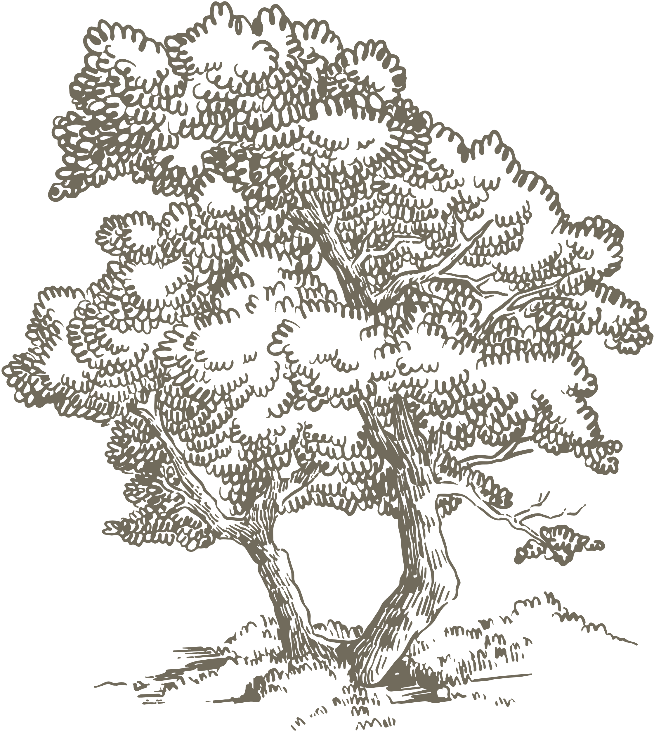
Features
Background Image: The application features a customizable background image to enhance the user experience.
Night/Light Mode: Users can switch between night and light modes for better visibility and comfort.
Brand Check: Users can input a brand name to check if it is on the boycotted list. The result is displayed with a clear message indicating whether to buy from the brand or not.
Exit Button: A convenient exit button allows users to close the application easily.

Slide 4

How It Works
User Input: Enter the brand name in the provided text entry field.
Check Function: The application reads from a text file containing the list of boycotted brands and compares the user input against this list.
Result Display: The result is displayed on the screen, indicating whether the brand is boycotted or not, with color-coded messages for clarity.
Switch Mode: Users can toggle between different background images to switch modes.

Slide 5

Requirement
1) window tkinter to show to the user all functions
2) label to guide the to entry the text 'Enter Brand name
3) entry to store the user brand
4) label to show the result
5) button to handle whether the brand is boycott or not
6) button to handle if the user want the front page is dark mode or normal
7) button to handle if the user want to exit

Slide 6
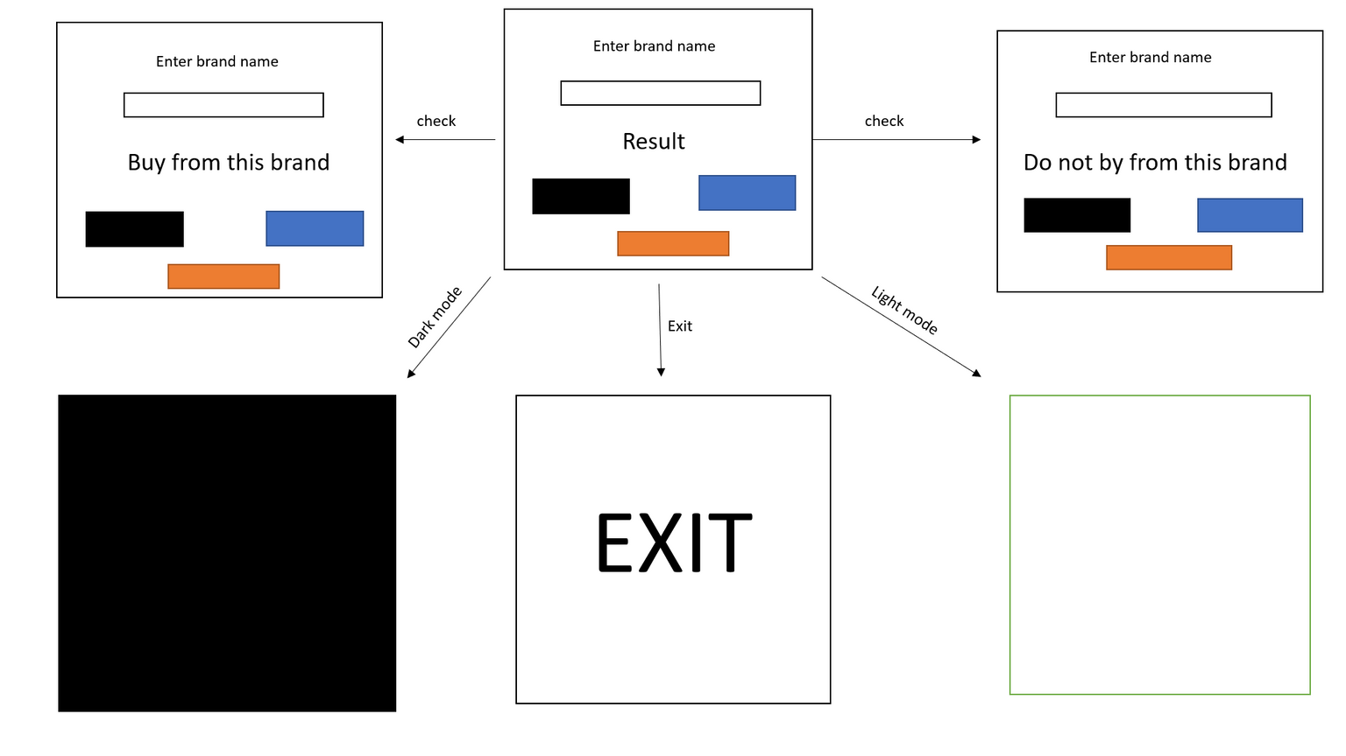
DESINE SCHEMA

Slide 7
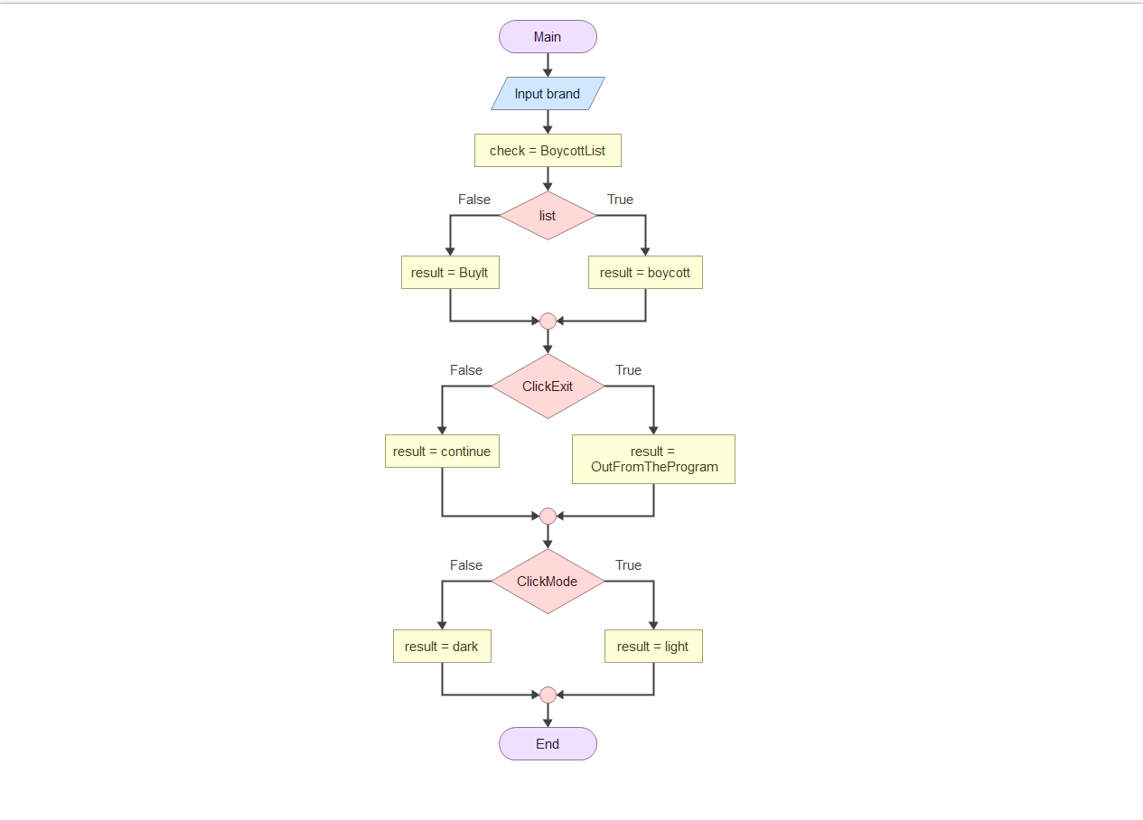
FLOWCHART

Slide 8
Conclusion
The Brand Checker Application is a practical tool designed to assist consumers in making informed purchasing decisions. By leveraging a simple yet effective interface, users can quickly determine whether a brand is on a boycotted list. The application’s features, such as customizable background images, night/light mode, and clear result displays, enhance the user experience and ensure ease of use.
This project demonstrates the power of Python's Tkinter library in creating user-friendly applications. It also highlights the importance of consumer awareness and the role technology can play in supporting ethical purchasing decisions.
We hope this application serves as a valuable resource for users and encourages mindful consumption. Thank you for using the Brand Checker Application!

Slide 9


Questions
&
Discussion

Slide 10



MADE BY

Slide 11
Thank You

